Slide 1
DRUG RECOMMENDATION BASED ON SENTIMENTAL ANALYSIS
CS6030 - NATURAL LANGUAGE PROCESSING MINI PROJECT
SUBMITTED BY
Sanjay Chinni Karthick.V-2018103586
Chandru.R-2018103017

Slide 2
INTRODUCTION
One of the most commonly found concerns among patients when confronted with any medical condition is which physician to trust. There are more people every day caring about the health and medical diagnosis problem but still many lose their lives due to medical errors. Survey says more than 12% medication errors are caused by doctors because they write prescriptions based on their experience which is quite limited. Hence, finding appropriate physicians to diagnose and treat medical conditions is one of the most important decisions a patient must make.Advancement in Data mining and Recommender Technologies helps patients to get information about the drug by just entering the disease they are suffering with.

Slide 3
OBJECTIVE
The of main objective is to design and implement a Drug Recommendation System that explore possibilities of potential knowledge from diagnosis history records and reviews and ratings on drugs to help doctors prescribe the correct medication and decrease the medication errors effectively. Sentimental Analysis is applied on the drug reviews and based on the probabilistic score of the side effects of the drugs the most apt and popular drug is recommended.

Slide 4
DATASETS
Drug Review dataset-The dataset is gathered from the UCI Machine Learning Repository for DrugReview which provides patient reviews on specific drugs along with related conditions and a 10-star patient rating reflecting overall patient satisfaction.It contains 7 columns ID, Drug name, Disease, Symptoms, Review, Rating, Date, Useful count
Drugs Side effects dataset-This dataset is again gathered from UCI Machine Learning Repository for Side Effects of Drugs along with some raw data gathered from druglib.com.This Dataset contains a lot of columns similar to the drug review dataset, but it does not have a lot of rows. Hence only the “Side Effects” column from this dataset will be combined with drug review datasets for recommendation.

Slide 5
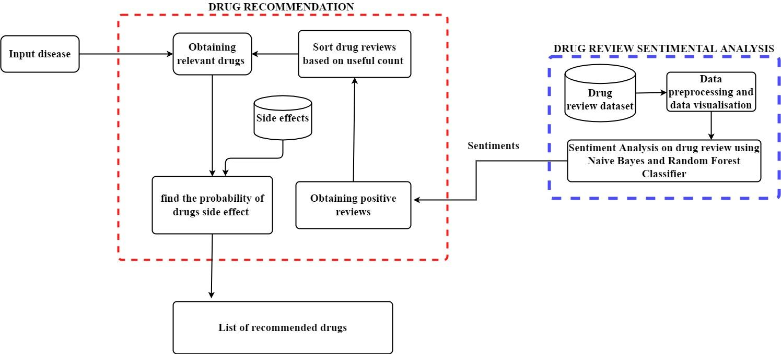
METHODOLOGY DIAGRAM

Slide 6
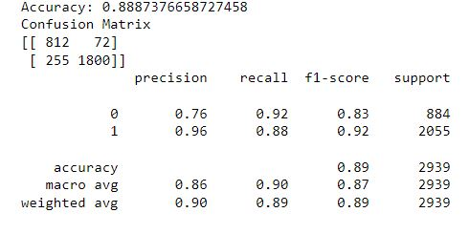
PERFOMANCE
Multinomial Naive Bayes and Random Forest Classifiers are used for Sentimental Analysis. Random Forest show comparatively high accuracy on this drug review dataset. It achieved an accuracy of 88.8%

